Slide 1

Analyzes the number of employees in each department, helping to understand workforce distribution and department size dynamics.
Employee Management System
H. Akhil
Ajay Kumar
G. Uma Mahesh

Slide 2


Introduction
This presentation provides a comprehensive overview of the Employee management system SQL project. It highlights some key queries with detailed explanations to help understand data handling within the system. The focus is on insights into employee data, payroll, salary, bonus, department analysis, roles, and leave management.

Slide 3
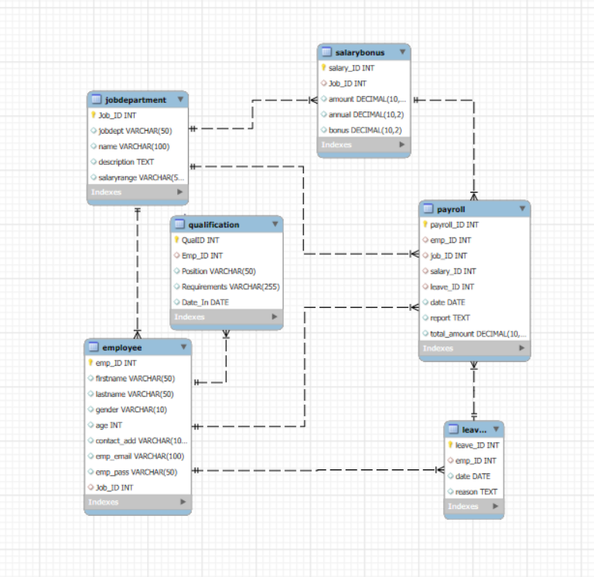

Slide 4

EMPLOYEE INSIGHTS

Slide 5
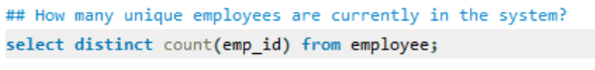
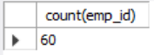
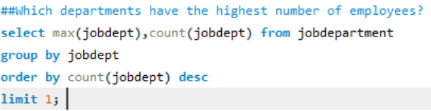
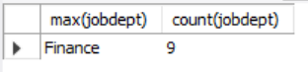

Slide 6
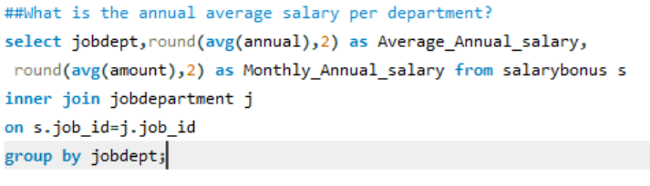
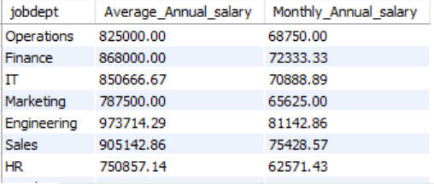

Slide 7
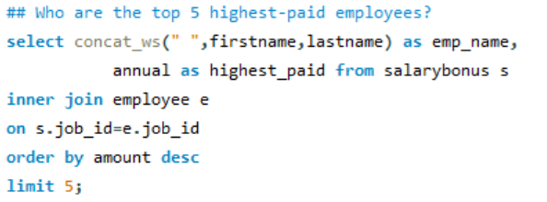
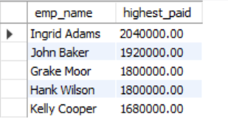

Slide 8
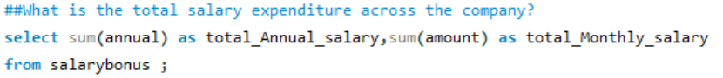
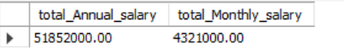

Slide 9

Job Roles and Department Analysis

Slide 10
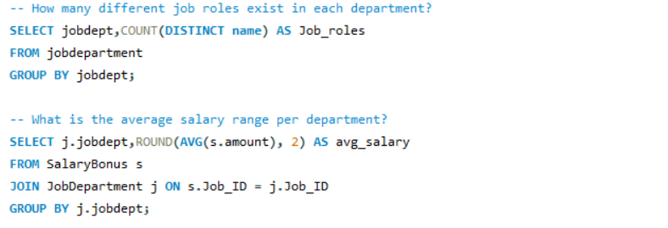
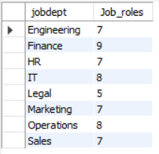
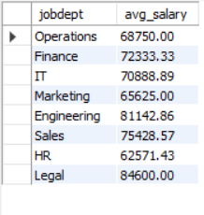

Slide 11
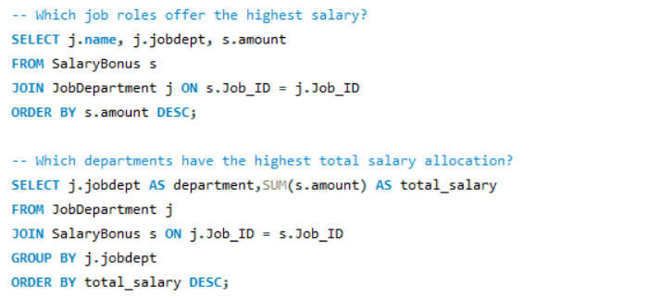
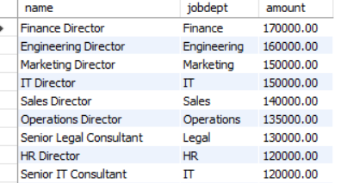
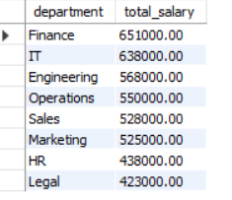

Slide 12

Qualification and Skills Insights

Slide 13
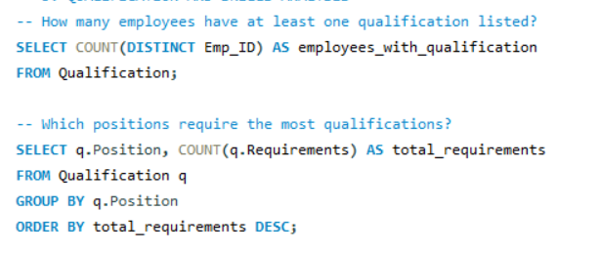
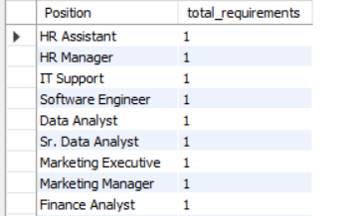
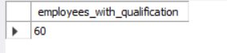

Slide 14
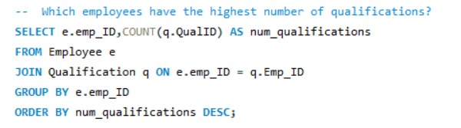
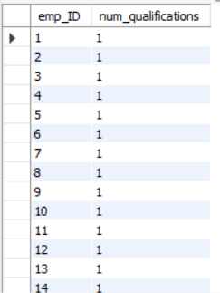

Slide 15
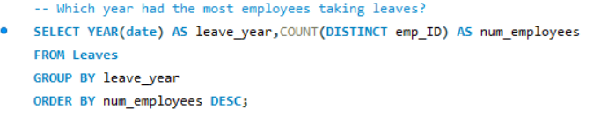
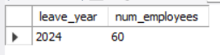
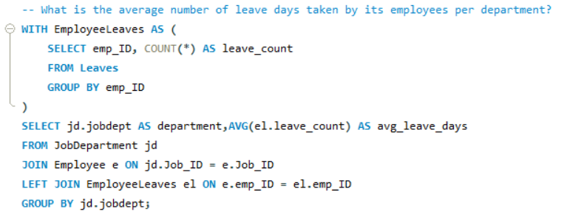
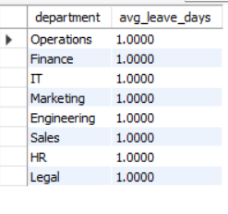

Slide 16
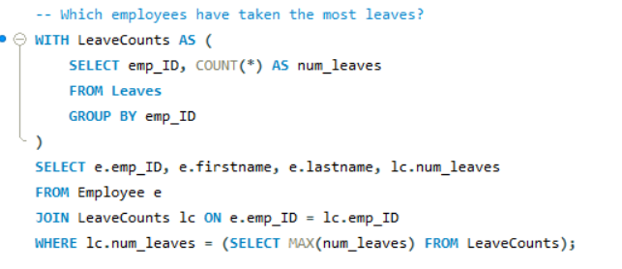
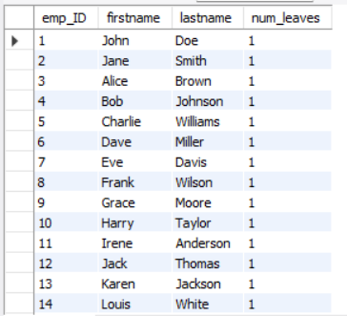

Slide 17
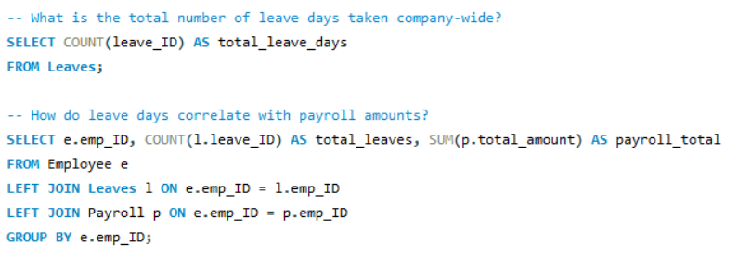
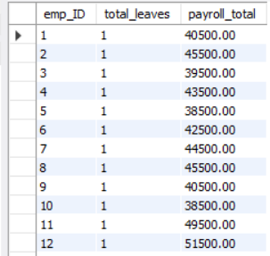
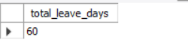

Slide 18

Payroll and Compensation Details

Slide 19
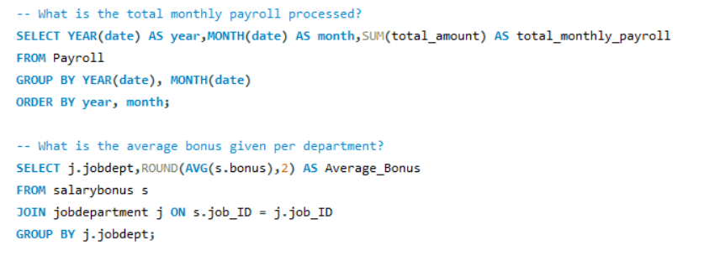
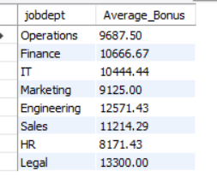
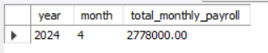

Slide 20
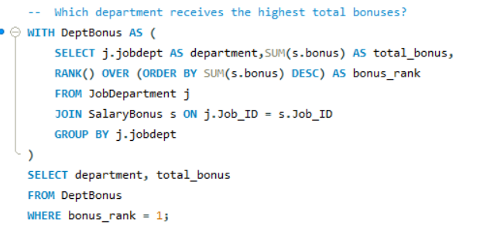
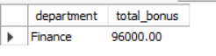
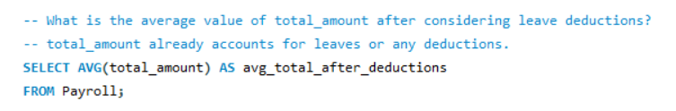
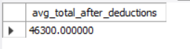

Slide 21

Conclusion:
This presentation covered key SQL queries used to analyze employee data, payroll, qualifications, leave, and performance within an employee management system.
These insights provide a solid foundation for data-driven HR decisions, financial oversight, and organizational development strategies aimed at optimizing workforce management.

Slide 22

Challenges
Defining correct table relationships and ensuring accurate use of foreign keys.
Maintaining data consistency with cascading updates and deletes.
Writing complex joins for reports involving employee roles, leaves, and payroll.
Ensuring all date fields follow the YYYY-MM-DD format for reliable time-based analysis.
Preventing duplicate entries using unique constraints, especially on email fields.

Slide 23

THANK YOU

